Slide 1

Your trusted partner in all Fintech journeys

Slide 2

Agency Profile
WHO WE ARE
SMARTOSC
FINTECH
FINTECH SOFTWARE
DEVELOPMENT
SERVICES
Full security and compliance
High performance
Cost Effective
Notes:
]

Slide 3
Agenda
Authentication and Authorization Flow
Keycloak – Authentication and Authorization Server
Spring Boot integration to Keycloak
Demo
Customize configuration Keycloak connect to PostgreSQL for Production environment

Slide 4
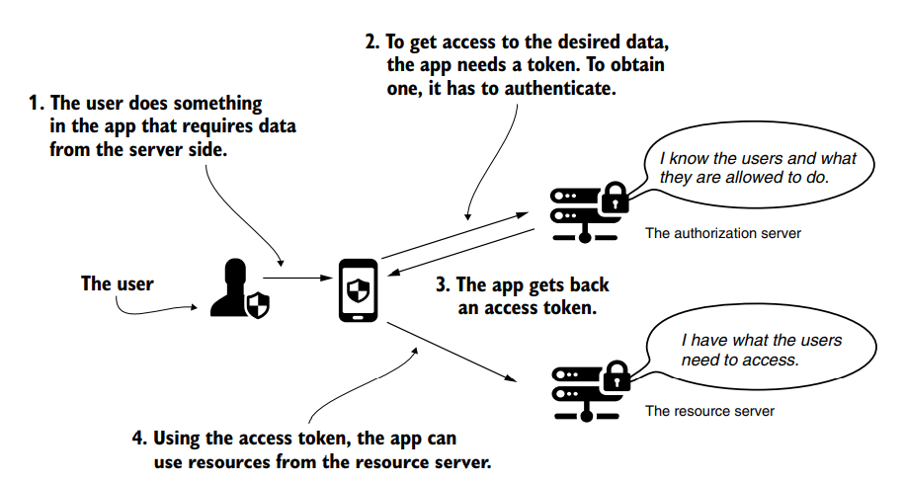
Authentication/Authorization Flow
The OAuth 2 authorization flow with password grant type.
To execute an action requested by the user (1), the application requires an access token from the authorization server (2).
The application receives a token (3) and accesses a resource from the resource server with the access token (4).

Slide 5
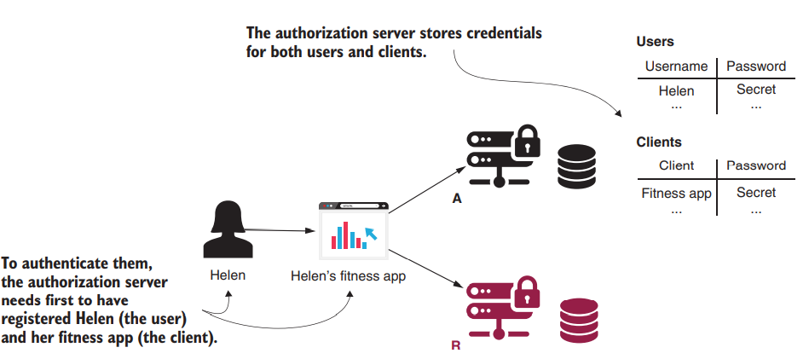
The authorization server stores the user’s and client’s credentials
The authorization server stores the user’s and client’s credentials. It uses the client credentials so that it only allows known applications to be authorized by it.

Slide 6
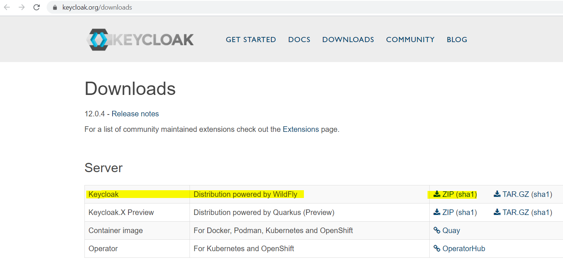
Keycloak Download

Slide 7
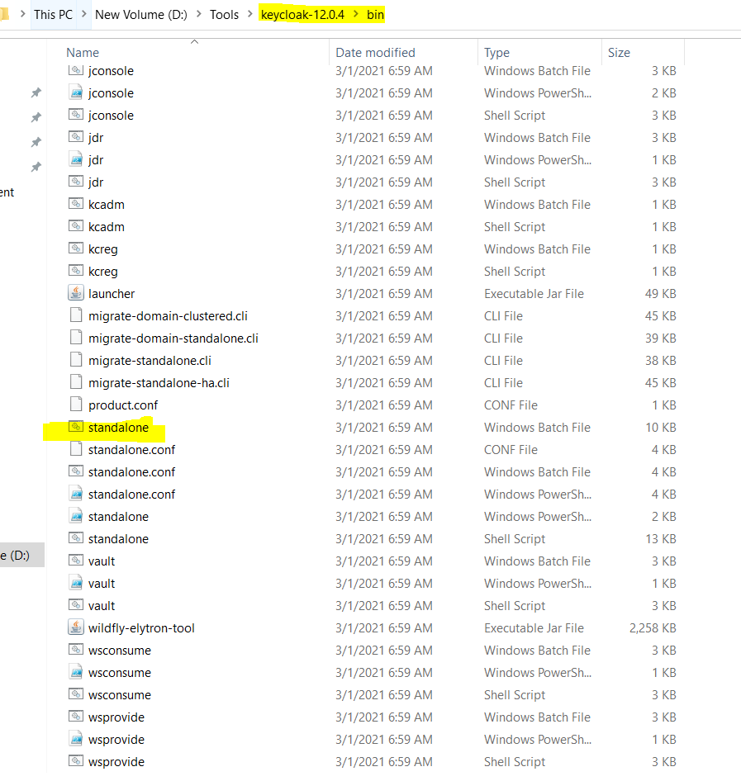
2. Keycloak – Authentication and Authorization Server

Slide 8
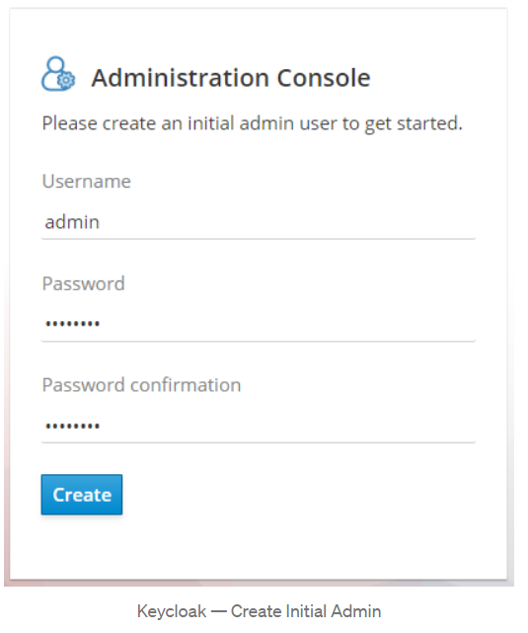
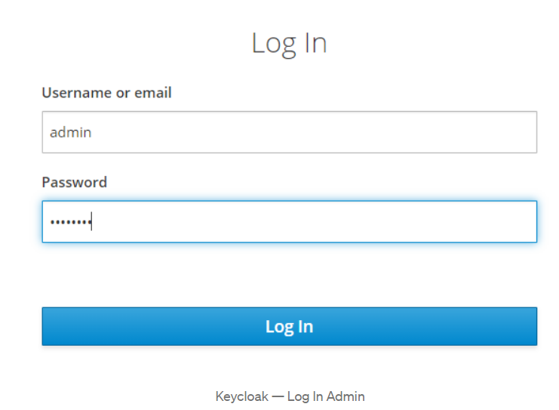
Create Initial Admin User
http://localhost:8080/auth

Slide 9
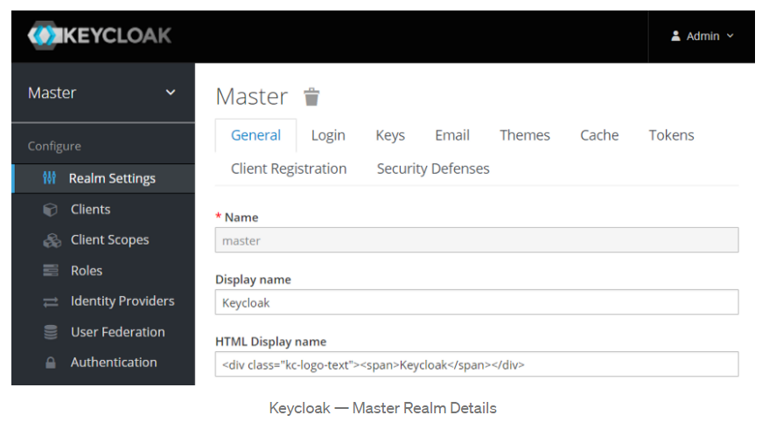
The first screen Keycloak shows after login is the Master realm details.

Slide 10
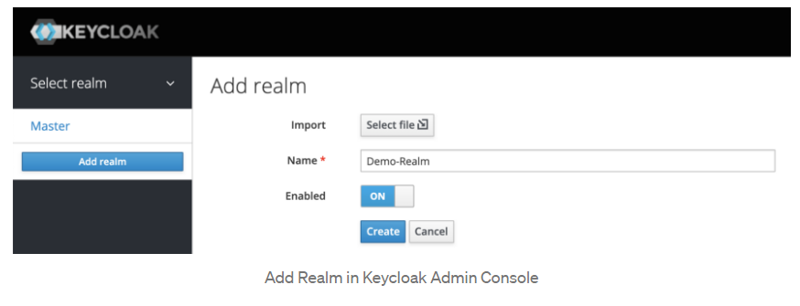
Keycloak Configuration
Create Realm
Type Demo-Realm in the Name field and click Create

Slide 11
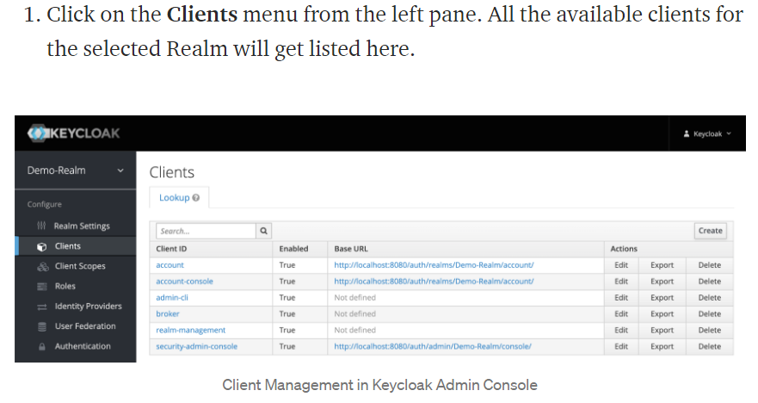
Create a Client
Clients are applications and services that want to use Keycloak to secure themselves and provide a single sign-on solution

Slide 12
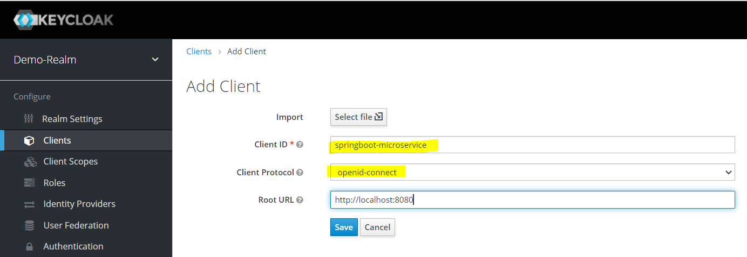
Create New Client

Slide 13
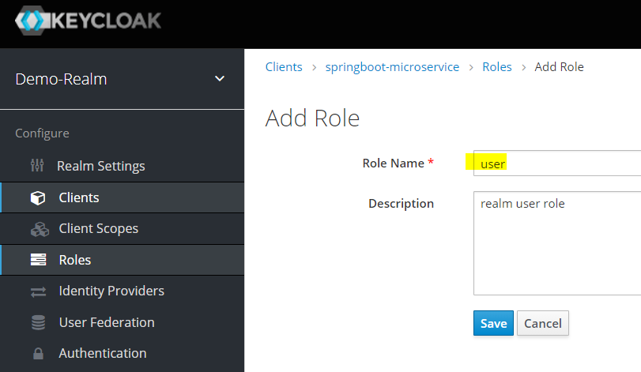
Create New Client – Add role

Slide 14
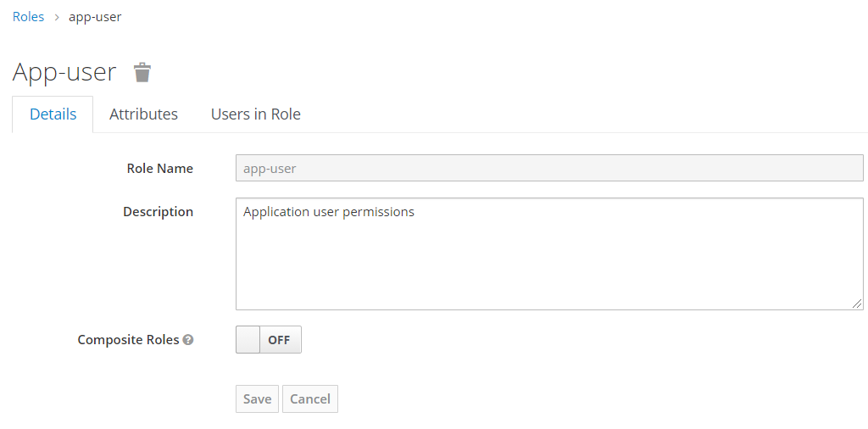
Create Realm Roles
Applications often assign access and permissions to specific roles rather than individual users
Create app-user and app-admin Realm roles by assigning corresponding springboot-microservice roles (user, admin).

Slide 15
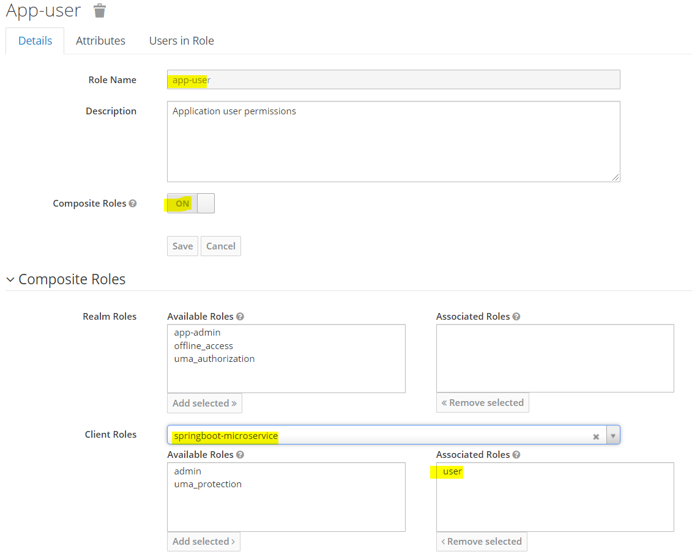

Slide 16
Create Users
Users are entities that are able to log into your system. They can have attributes associated with themselves like email, username, address, phone number, and birth day. They can be assigned group membership and have specific roles assigned to them.
Create following users and grant them app-user and app-admin roles for testing purposes.
employee1 with app-user realm role
employee2 with app-admin realm role
employee3 with app-user & app-admin realm roles

Slide 17
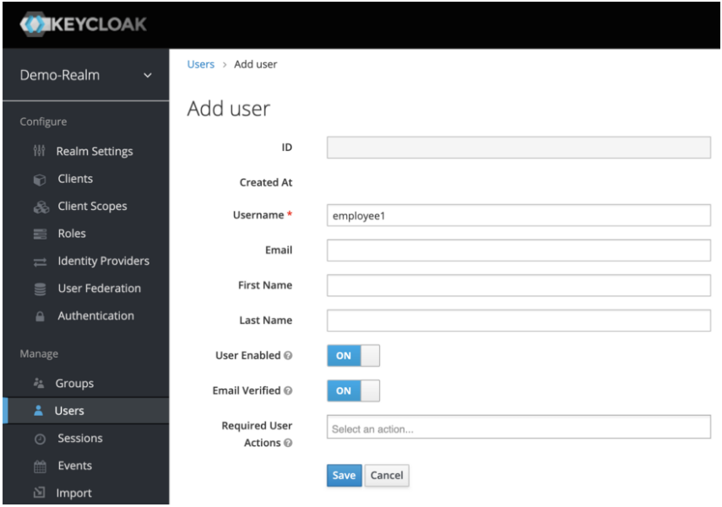
employee1 with app-user realm role

Slide 18
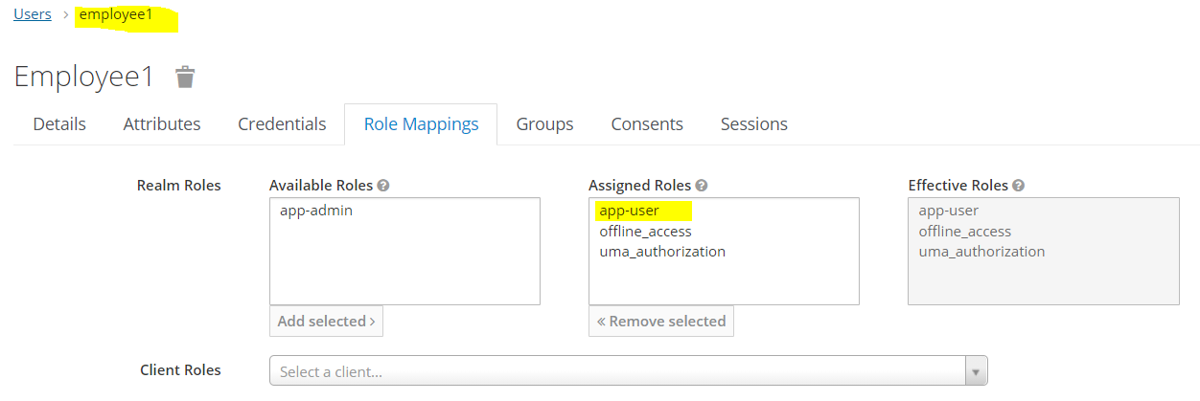

Slide 19
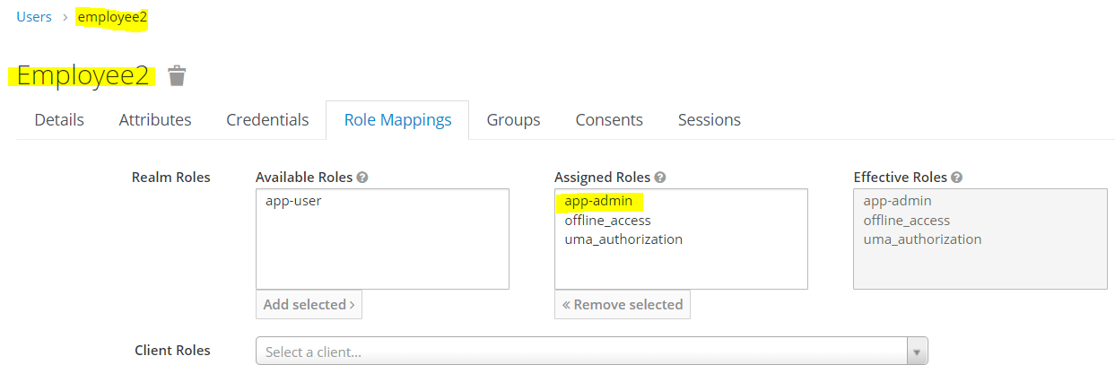

Slide 20
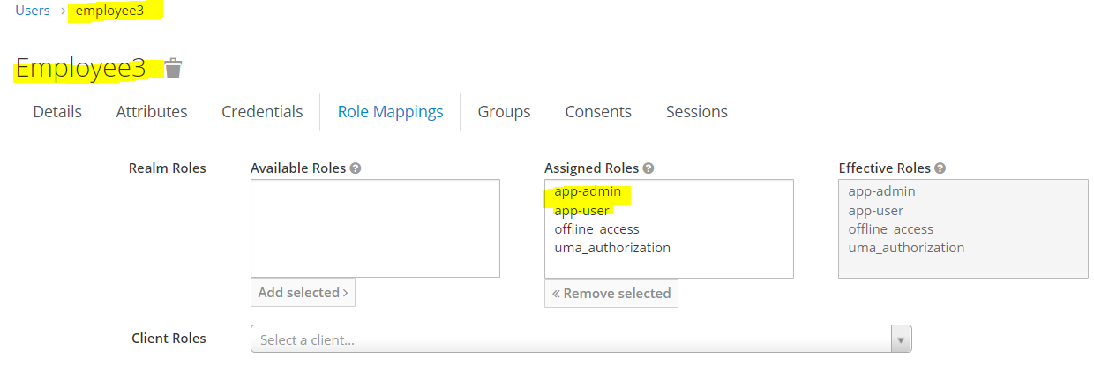

Slide 21
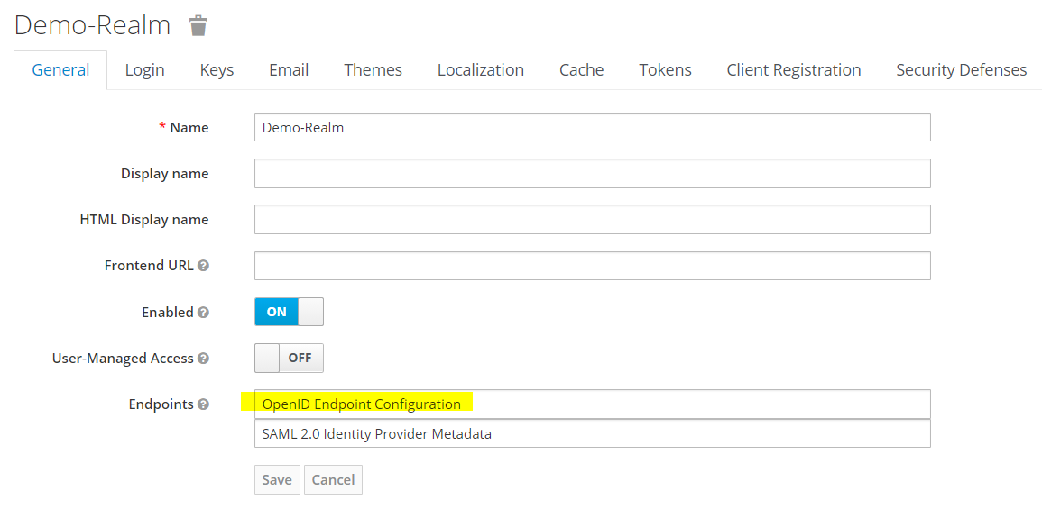
Check Keycloak configuration

Slide 22
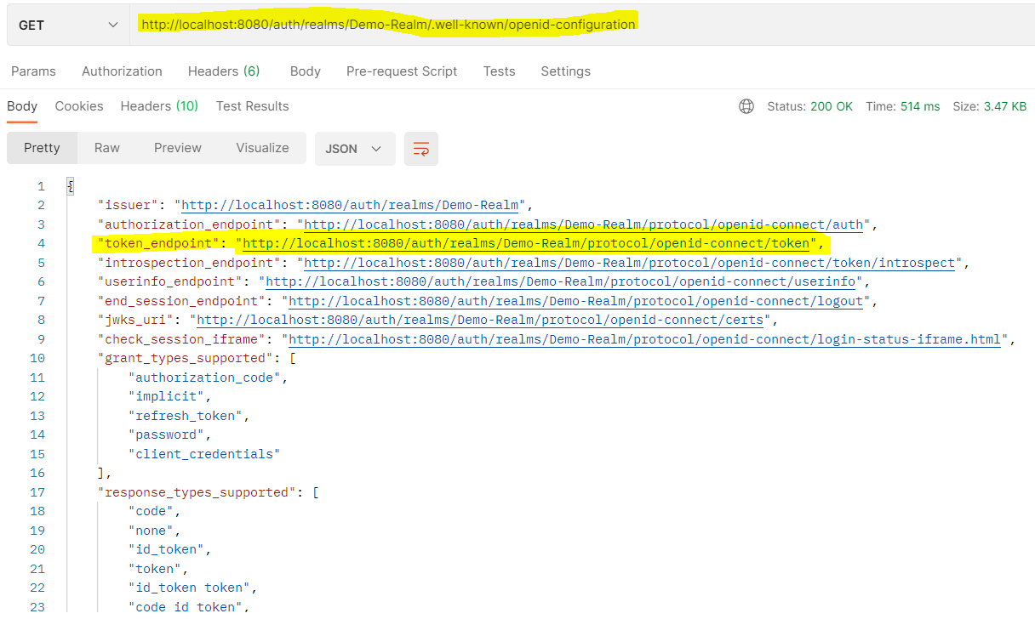

Slide 23
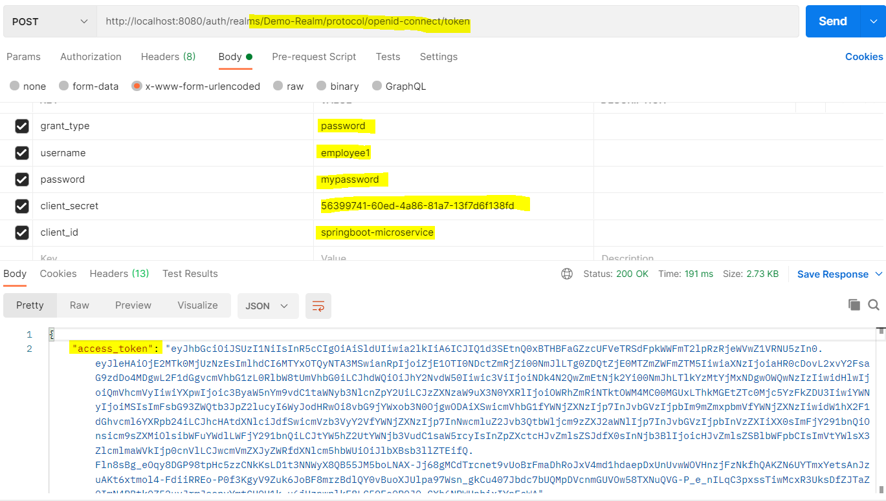

Slide 24
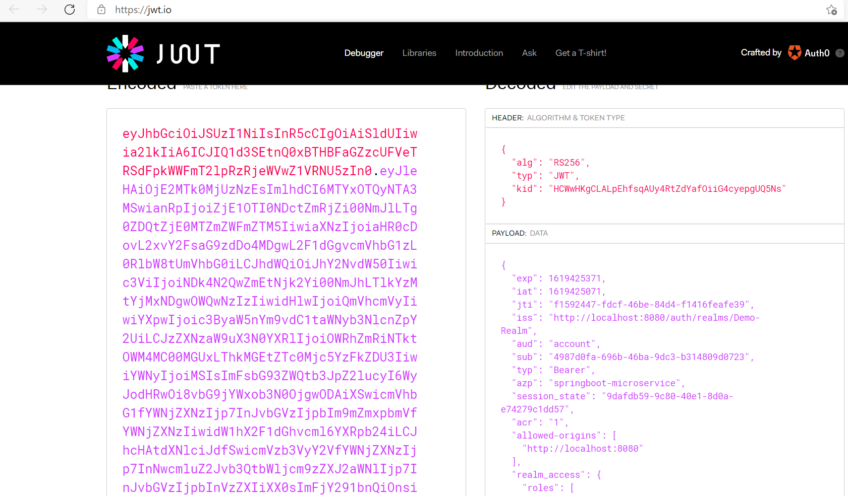
Convert the token

Slide 25
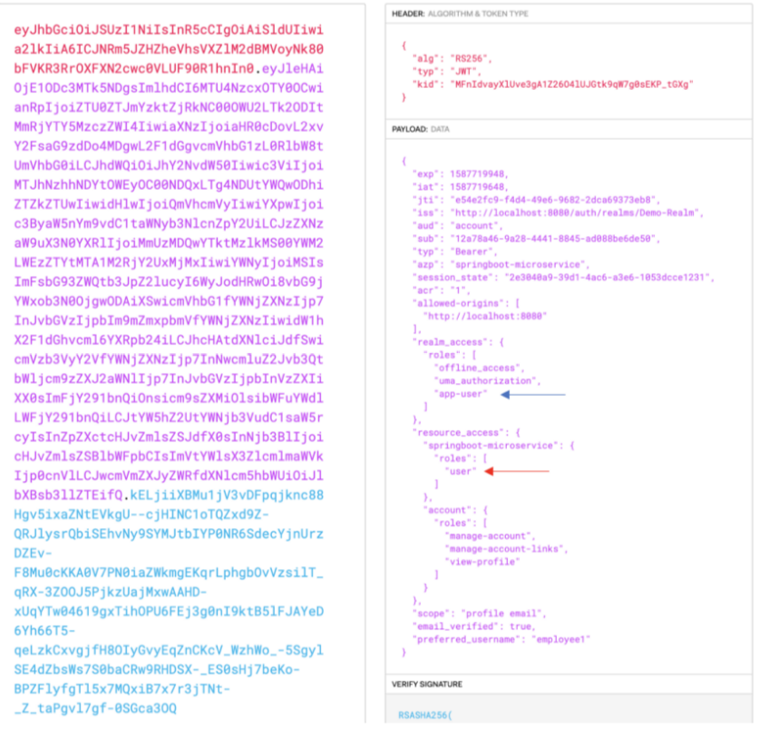

Slide 26
DEMO

Slide 27
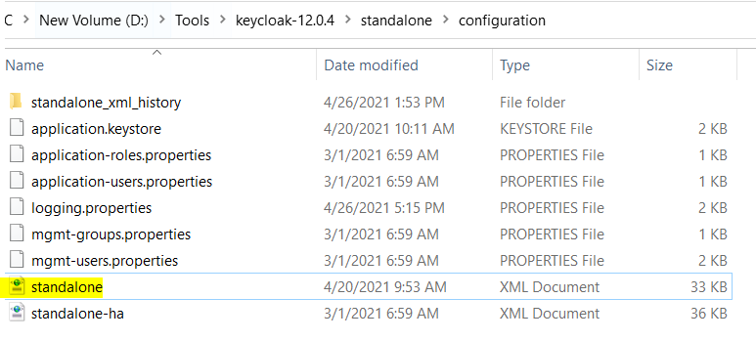
Change DB configuration to PostgreSQL for Production
By default Keycloak build-in with H2 DB – only for testing.

Slide 28
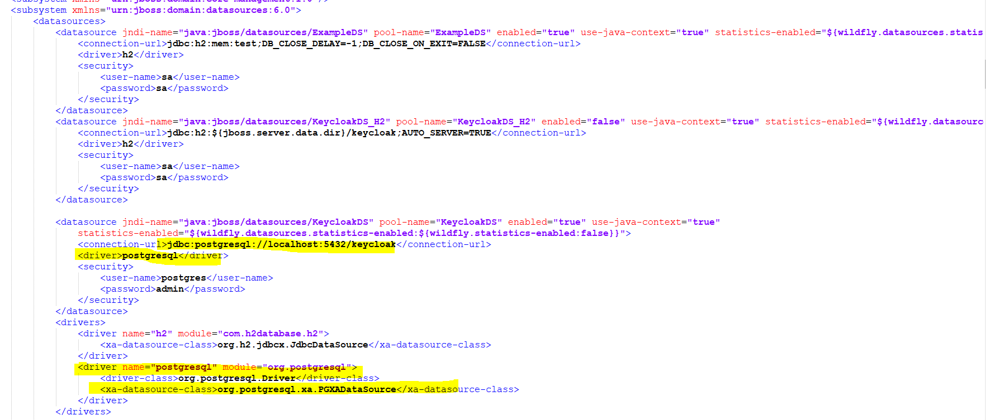

Slide 29
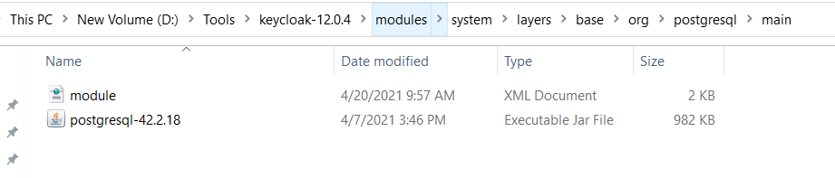
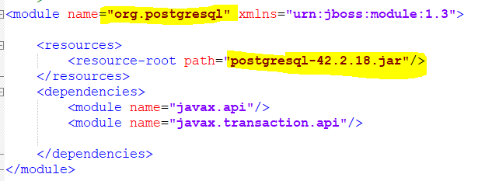

Slide 30
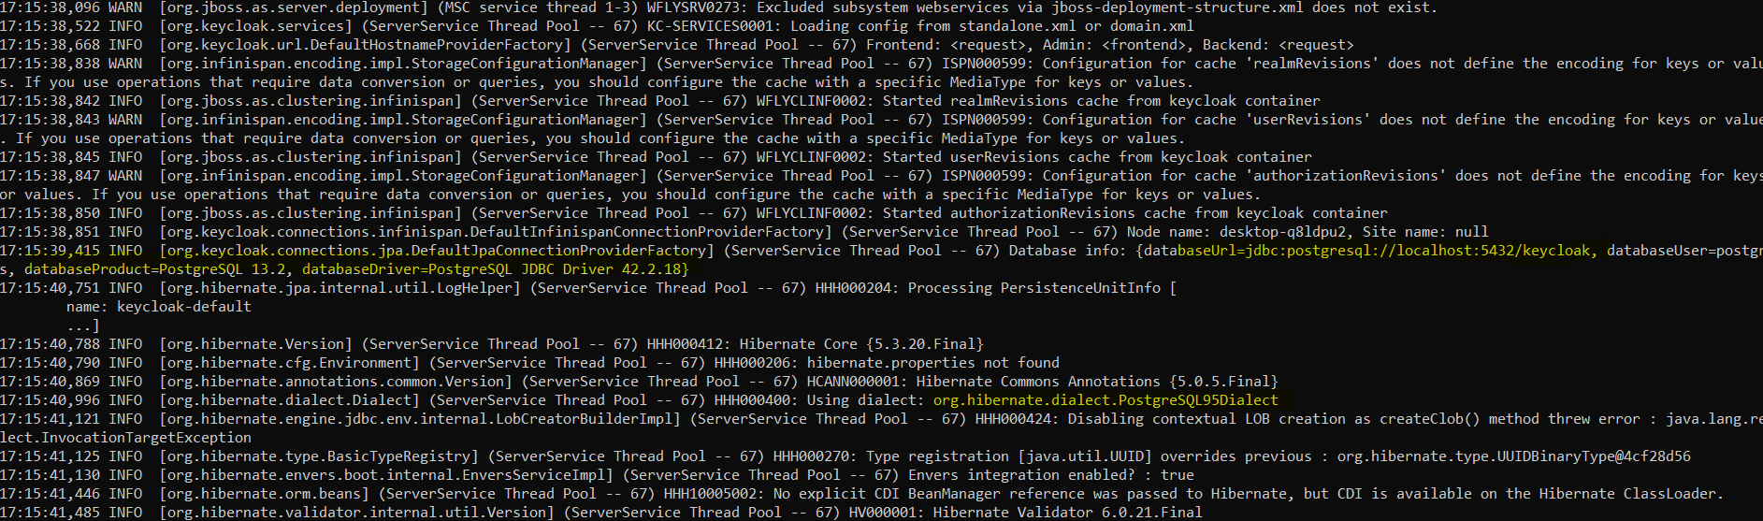

Slide 31
THANK YOU

